Slide 1
CAT Hackathon Presentation
Newbies Team

Slide 2
Introduction

Slide 3
Agenda
01
02
03
Data cleaning
Data imputation
Modeling

Slide 4



Our Team
Khaled Zakarya
Mohamed Kardosha
Mohamed Elkerdawy

Slide 5
01
Data cleaning

Slide 6
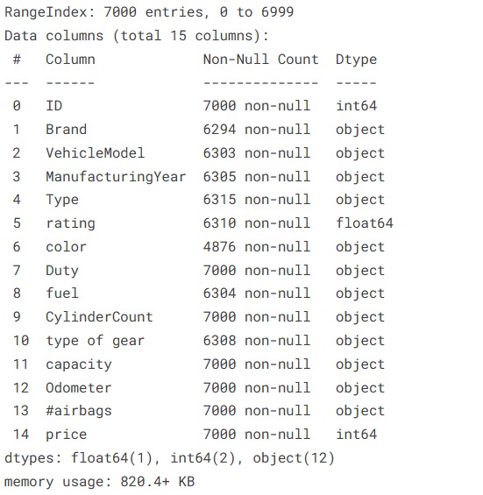
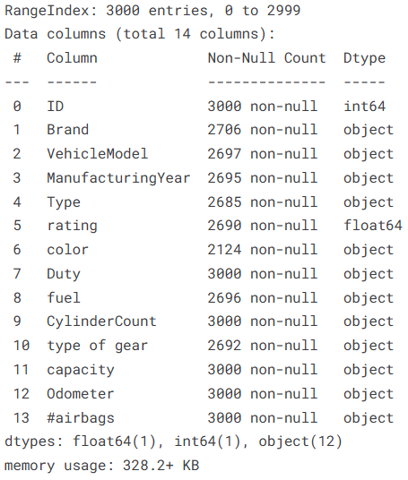
Missing values and data types
Train
Test

Slide 7
02
Data Imputation

Slide 8
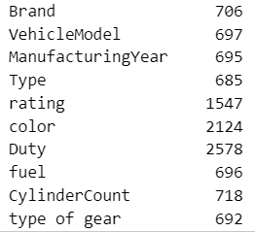
Nan Values pridection
Nan values count

Slide 9
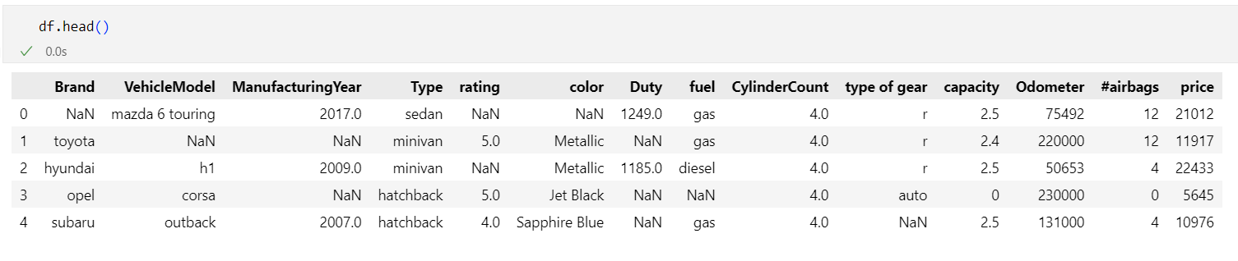
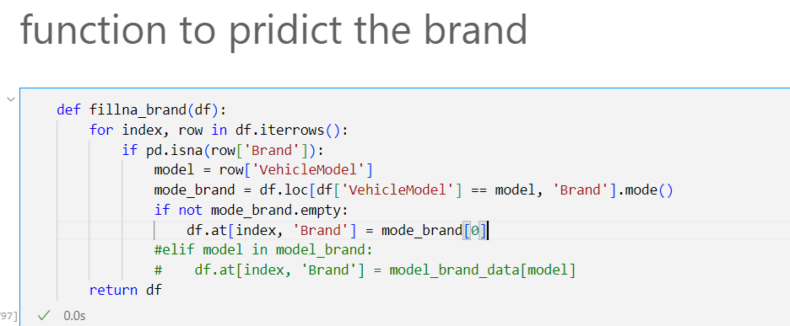
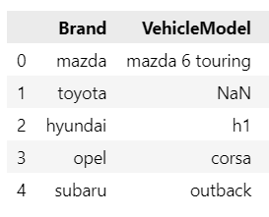
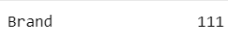
Nan Values pridection(Brand)

Slide 10
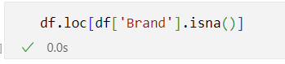
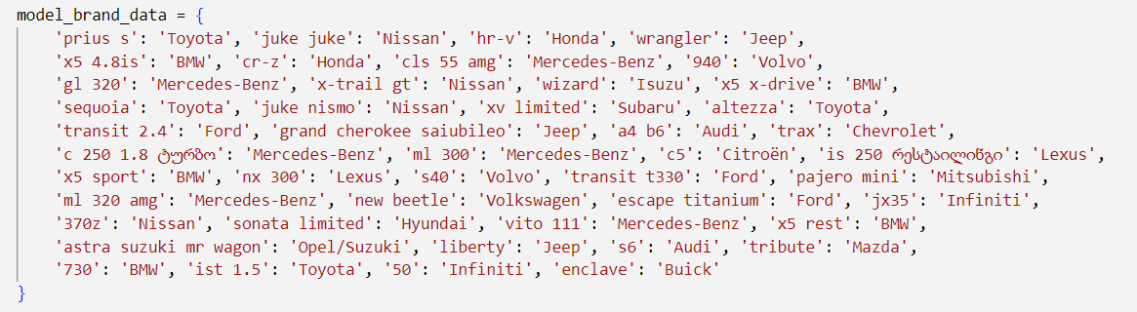
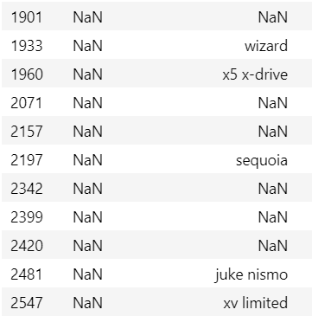
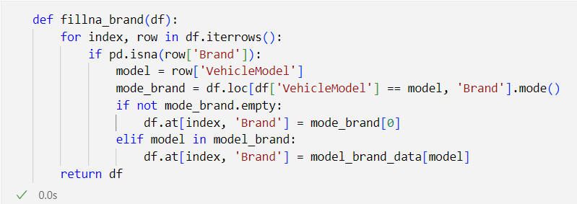
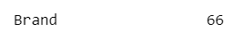

Slide 11
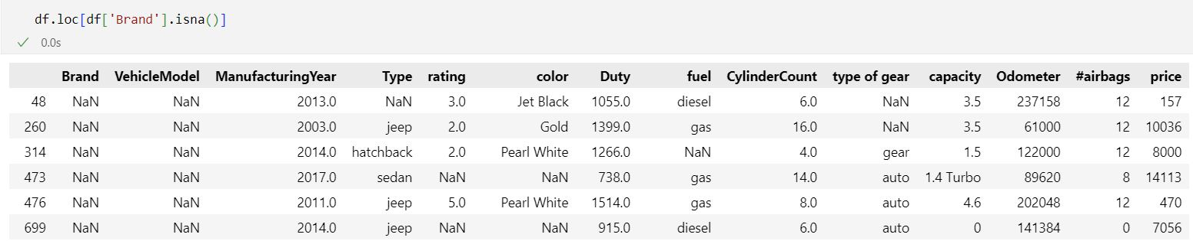
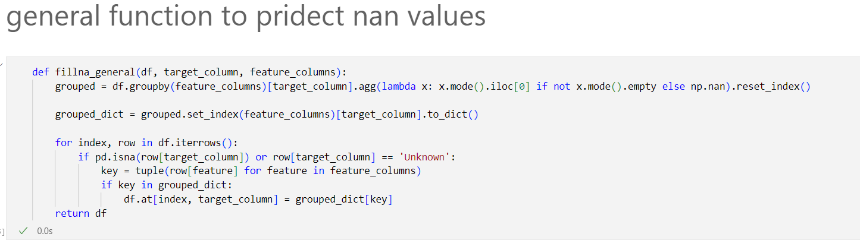
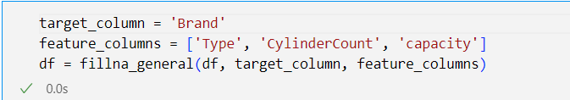
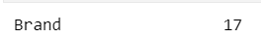

Slide 12
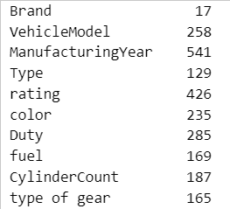
Nan Values pridection
Nan values count

Slide 13
03
Modeling

Slide 14
What to do next?

Slide 15
Thanks
Do you have any questions?
Presented by
Newbies Team

